Slide 1

How To Foresee A Flood Using Spatial Data Science
Terrain Data Type and Flow Models: SFD vs. MFD
CSCI5715 Fall’20 G1: Harish Panneer Selvam & Matthew Eagon
Mathias Rav, Aaron Lowe, and Pankaj K. Agarwal. 2019. Flood Risk Analysis on Terrains. ACM Trans. Spatial Algorithms Syst. 5, 1, Article 2 (June 2019), 31 pages. DOI:https://doi.org/10.1145/3295459
Shekhar, Shashi. "Technical perspective: Progress in spatial computing for flood prediction." Communications of the ACM 63, no. 9 (2020): 93-93.
Notes:
Hi I am Harish Panneer Selvam, and Matt Eagon and I will be covering

Slide 2
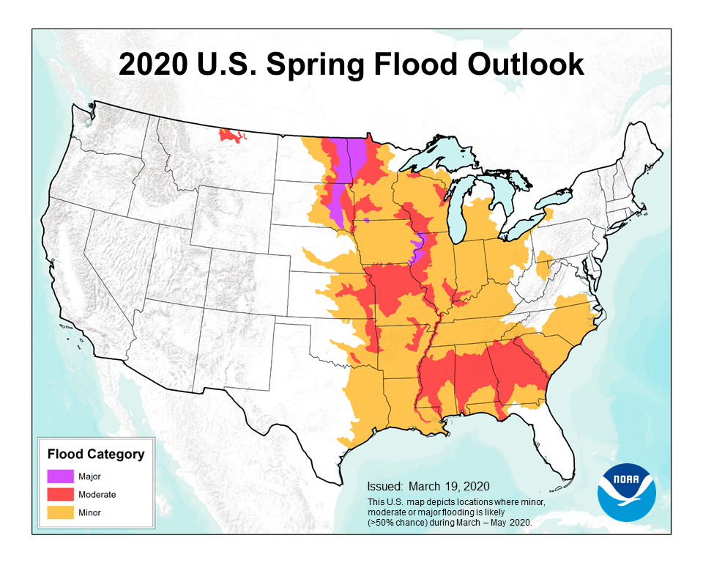
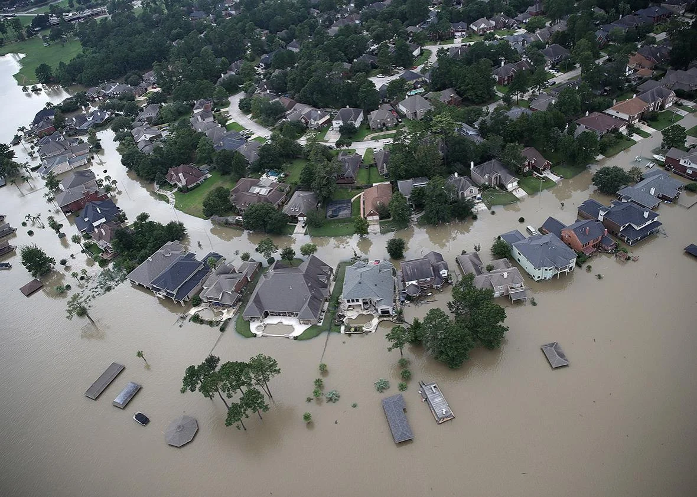

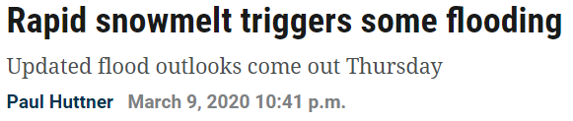


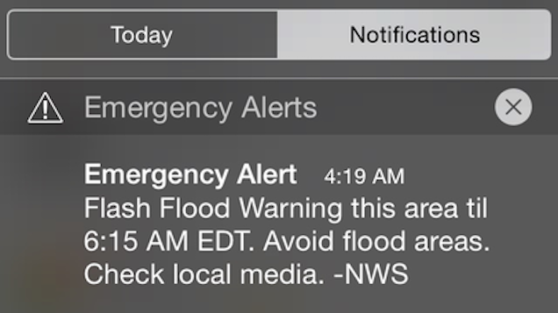

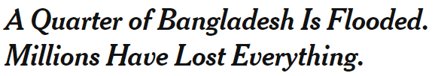

Motivation
HOUSTON, TX: Flooded homes are shown near Lake Houston following Hurricane Harvey August 30, 2017 in Houston, Texas.
Damages from Harvey topped $112 billion USD.
(Photo by Win McNamee/Getty Images)
Notes:
Flooding causes:
Loss of human lives
Damage to property
National Oceanic and Atmospheric Administration
Risk-analysis needed for:
Infrastructure planning
Early warning systems
Insurance risk assessment

Slide 3
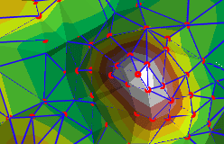
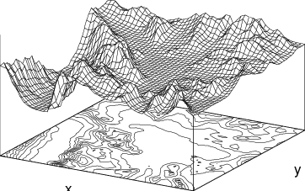
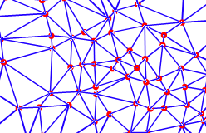
Terrain Data Type
Represents a terrain as a graph
Each node has an associated elevation
Node heights determine edge flow direction
Triangulated Irregular Network (TIN)
Digital Elevation Model

Slide 4
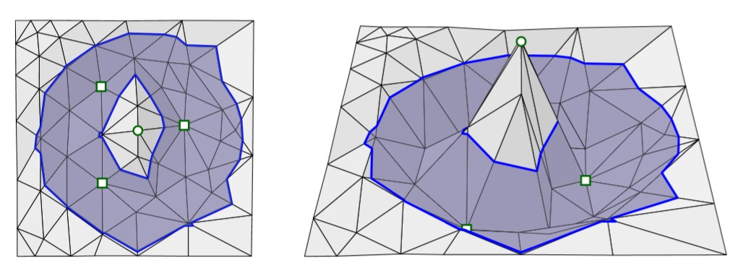
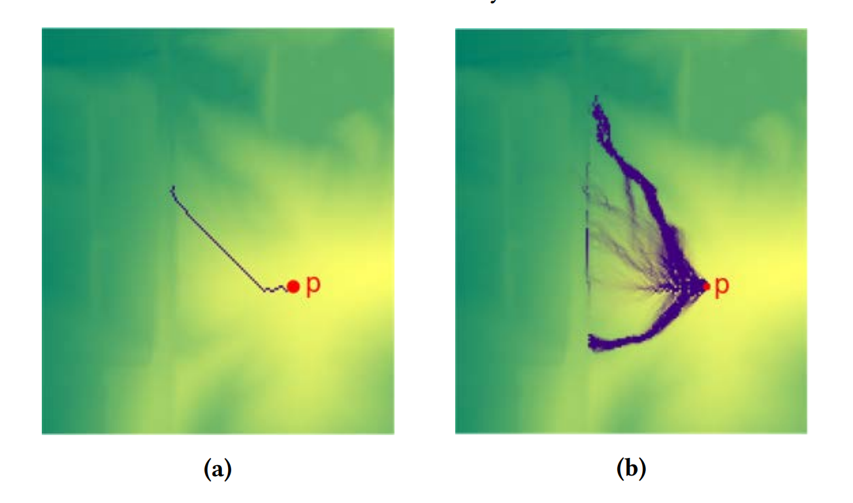
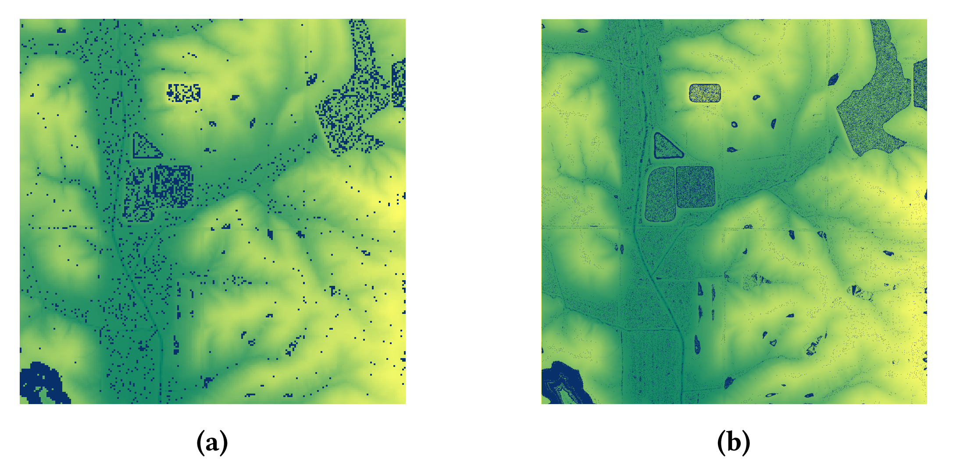
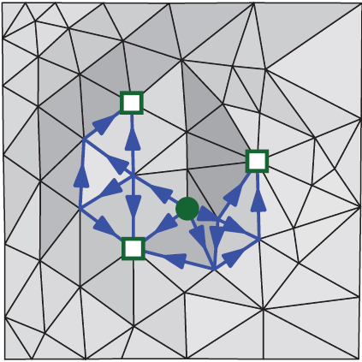
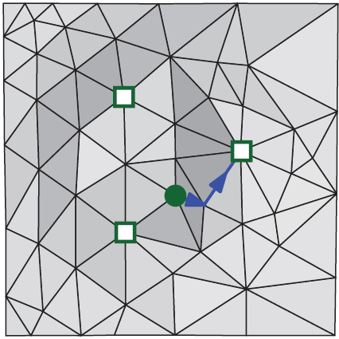
Flow Models - SFD vs MFD
Fill one sink at a time or allow water to flow to any neighbor?
What happens if water fills a depression and overflows?
Single-flow direction model (SFD) Multi-flow direction model (MFD)
All water falls at point p
Water falls uniformly over an area
All water falls at point p
Water falls uniformly over an area
Lowe, Aaron, and Pankaj K. Agarwal. "Flood-Risk Analysis on Terrains under the Multiflow-Direction Model." ACM Transactions on Spatial Algorithms and Systems (TSAS) 5, no. 4 (2019): 1-27.
Notes:
The flow model determines how water flows from high point nodes to low point nodes.
SFD: All water flows from high point to single lowest point that is not yet full.
MFD: Some fraction of water can flow from high points to any neighboring low points.

Slide 5
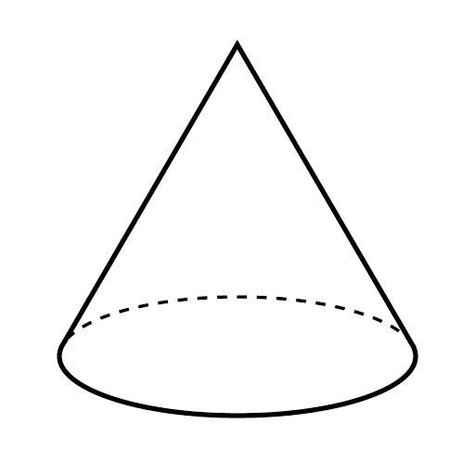
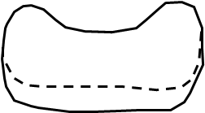

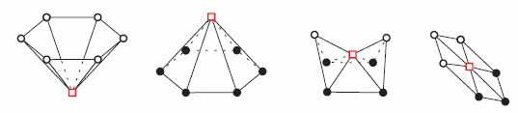
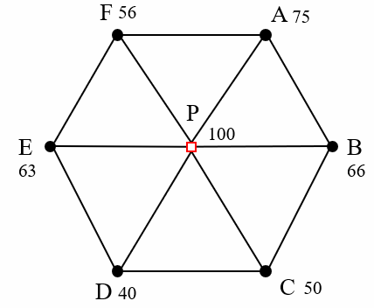
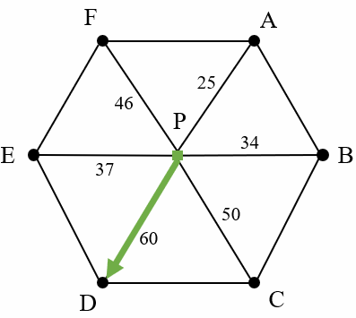
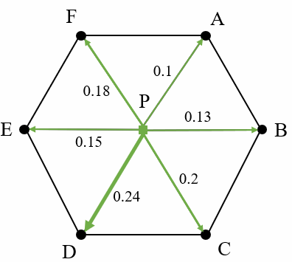
Flow Model Construction
Turn surface into a triangulated irregular network (TIN)
Use node height function to classify nodes
Determine edge flow directions and weights
Example:
surface
TIN
Node heights
SFD flow direction
MFD flow direction
Notes:
Simple TIN from toy example hill terrain
Node classification/height function → represent heights as raster data (grid matrix of heights of surrounding nodes)
SFD → direction of largest descent
MFD → downhill everywhere with some cost/aportionment
Basic construction for the two flows models begins the same way. First, a surface is discretized into a triangulated irregular network (TIN) []. There are some simple examples here of cones, saddle points, and planes. And finally [], the flow directions from node to node are determined based upon the model chosen. For an example we’ll look at the flow around a simple TIN created from a cone-like surface where water is flowing from the single high-point P. The heights of each node are shown next to the names. [] For the SFD model, all water is assumed to flow in a single direction along the edge where the change in height is maximized. On the other hand, the MFD model allows water to flow in all directions where the height decreases, and the portion of water that flows in each direction depends on the normalized change in height.

Slide 6
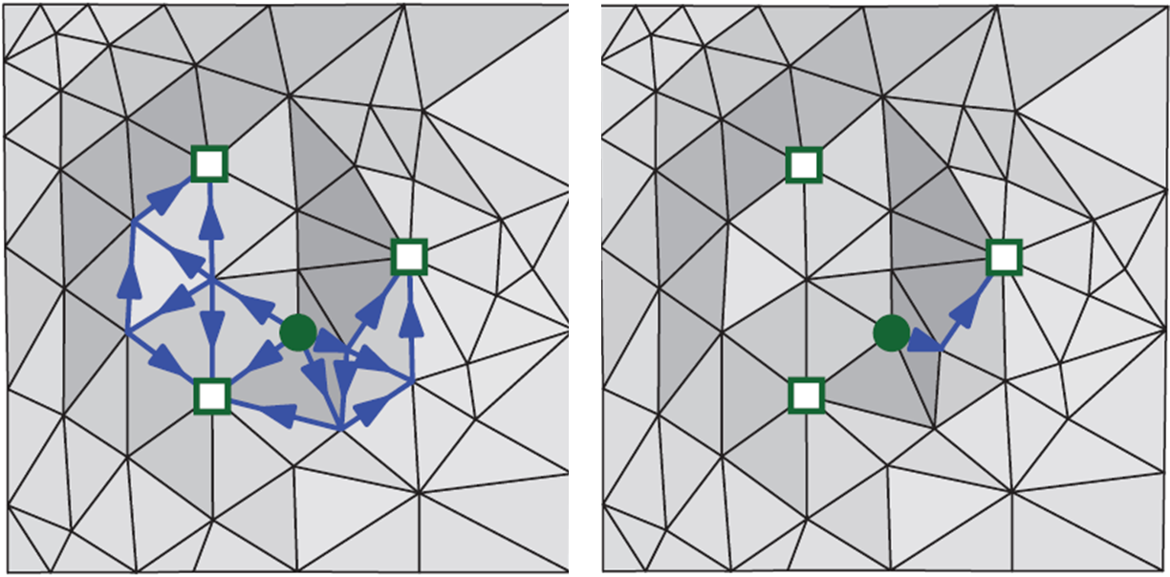
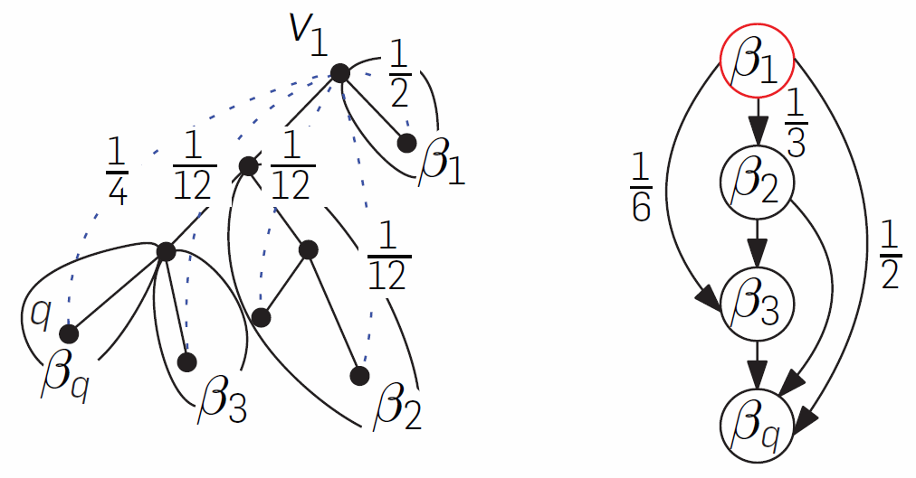


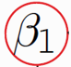

Connection to Spatial Data Science
GIS to get triangulated irregular network (TIN) from a surface
Terrain data with associated spatial queries
Transitive closure methods used for MFD ( time complexity O(mn) )
Tributary graph modeling
origin
tributaries
Tributary graph for SFD
Tributary graph for MFD
Notes:
This is connected to a few different aspects of our class. First, GIS software can be used to create TINs from geographic data. Second, the terrain data and its associated queries are extensions of the graph structures and spatial data queries we were learning a bit about in chapters 2, 4, and 6. And finally, transitive closure of a directed graph which we spoke about in a previous class is used to differentiate the SFD and MFD models. The low-points on a TIN where water would accumulate are called tributaries, and in the SFD model, water just flows to one tributary at a time, whereas in the MFD model, some portion of water can flow to all the reachable tributaries from a single origin point. So a [] tributary graph for MFD can be computed from the transitive closure of an SFD tributary graph.

Slide 7
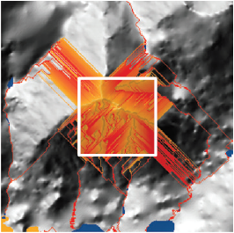
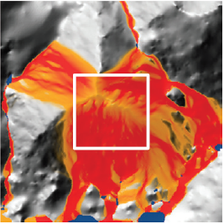
Conclusion
SFD flow
MFD model may reduce approximation error (more realistic) compared to SFD, however SFD is more computationally efficient.
See paper for more information on:
Flood query algorithms
Equations for depression filling
Other flood prediction methods
MFD flow
Mathias Rav, Aaron Lowe, and Pankaj K. Agarwal. 2019. Flood Risk Analysis on Terrains. ACM Trans. Spatial Algorithms Syst. 5, 1, Article 2 (June 2019), 31 pages. DOI:https://doi.org/10.1145/3295459
Notes:
To wrap up, you can learn more about this area of research and these more in-depth topics like flood query algorithms from the paper. But the main takeaway from this short tutorial is that the MFD model you’ve just learned about may reduce approximation error compared to SFD since water can flow in a more intuitively natural way. But SFD is historically more widely used by civil engineers and others for flood risk analysis because it’s much more computationally efficient. This example from the paper shows the edges that water flows along in a simulation of rainfall on a mountain. The SFD flows are quite linear looking whereas the water spreads out more in the MFD model in a way we might intuitively expect.

Slide 8
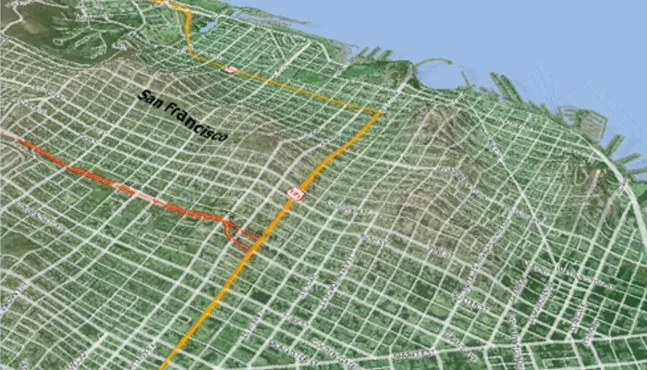
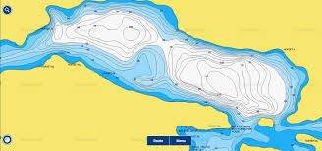
Quiz
1. Which is not commonly used in terrain representation?
Digital elevation model
Triangulated irregular network
R-tree
Contour map
1. Which is not commonly used in terrain representation?
Digital elevation model
Triangulated irregular network
R-tree
Contour map
Digital elevation model
Contour map of a lake
Notes:
Answer: C

Slide 9
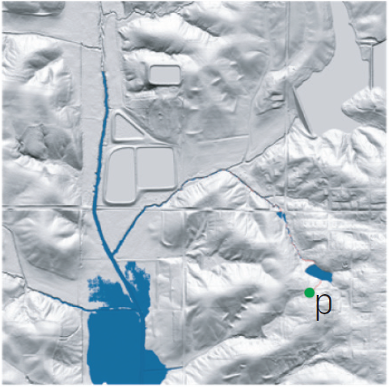
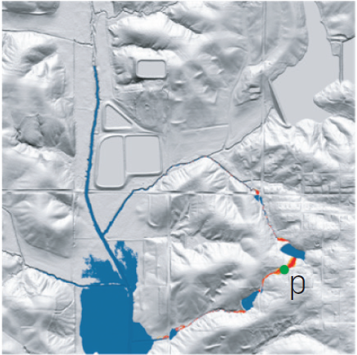
Quiz
2. What is not a benefit of using the MFD model as opposed to an SFD model?
MFD allows for more realistic flow patterns than SFD.
Flood queries are more computationally efficient for MFD.
MFD has less inherent approximation error than SFD.
MFD can be constructed using transitive closure of SFD graphs.
2. What is not a benefit of using the MFD model as opposed to an SFD model?
MFD allows for more realistic flow patterns than SFD.
Flood queries are more computationally efficient for MFD.
MFD has less inherent approximation error than SFD.
MFD can be constructed using transitive closure of SFD graphs.
Point-flood query
SFD: p not flooded
Point-flood query
MFD: p flooded
Notes:
Answer: B
Should note: D really refers to the tributary graphs, but if nodes are ordered intelligently, then you can compute the MFD graph from the SFD graph using transitive closure in O(m log n).

